Slide 1
Title:
PRICE PER KILOGRAM
Aim:
To be able to calculate the cost for
500 grams
100 grams
200 grams

Slide 2
PRICE PER KILOGRAM
AIMS
To be able to;
Define Sample Space
Describe how likely it is that an event will occur with spinners
Calculate cost for multiples of 100 grams from the kilogram price
PLAN
Describing Chance Exercise
Price Per Kilogram activity

Slide 3
Choral response
Sample space is the list of ALL possible outcomes of a trial.
Sample space is the list of ___ possible outcomes of a trial.
Sample space is the list of ___ possible ________ of a trial.
What is a sample space?

Slide 4
How to write {sample space}
I do
You do
Rolling a dice
S =
Flipping a coin
S =
Flipping 2 coins
S=
Picking a number between 1 and 10
Picking a letter from: FIREBALL
Rolling a 8 sided die

Slide 5
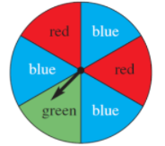
Coloured spinner
What is the sample space?
S = {red, blue, red, blue, green, blue}
Red is
Blue is
Green is
Yellow is
Impossible
Certain
Likely
Unlikely
Even chance

Slide 6
Drawing spinners
This spinner has an even chance for red and blue
Even chance of yellow but red is unlikely
Impossible for red, even chance for green

Slide 7
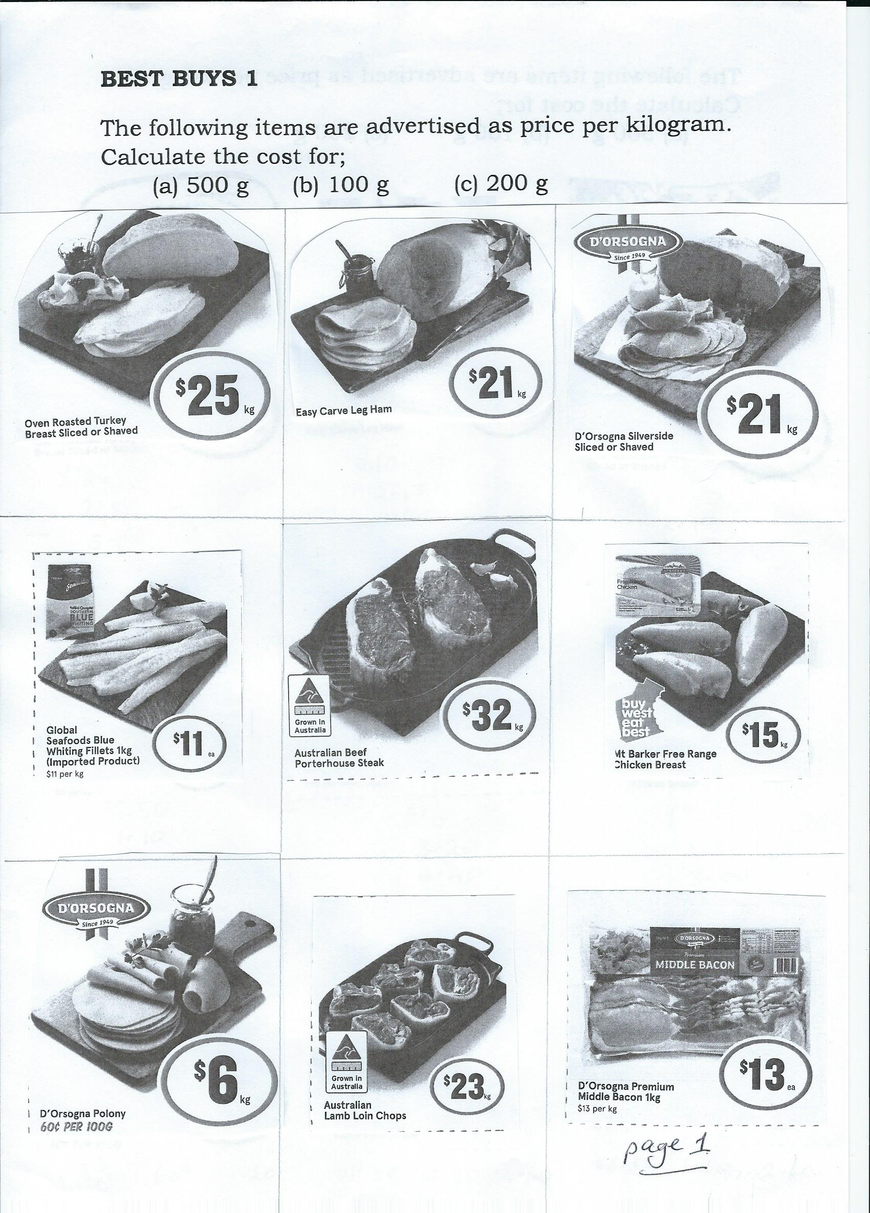
PRICE PER KILOGRAM
Page 1 worksheet required

Slide 8
PRICE PER KILOGRAM
REVIEW:
1. How many grams in one kilogram?
1 kg = ……… g
2. How many lots of 500 grams in one kilogram? ……
1 kg ÷ ….. = 500 g
3. How many lots of 100 grams in one kilogram? ……
1 kg ÷ ….. = 100 g
4. How many lots of 500 grams in one kilogram? ……
1 kg ÷ ….. = 200 g

Slide 9
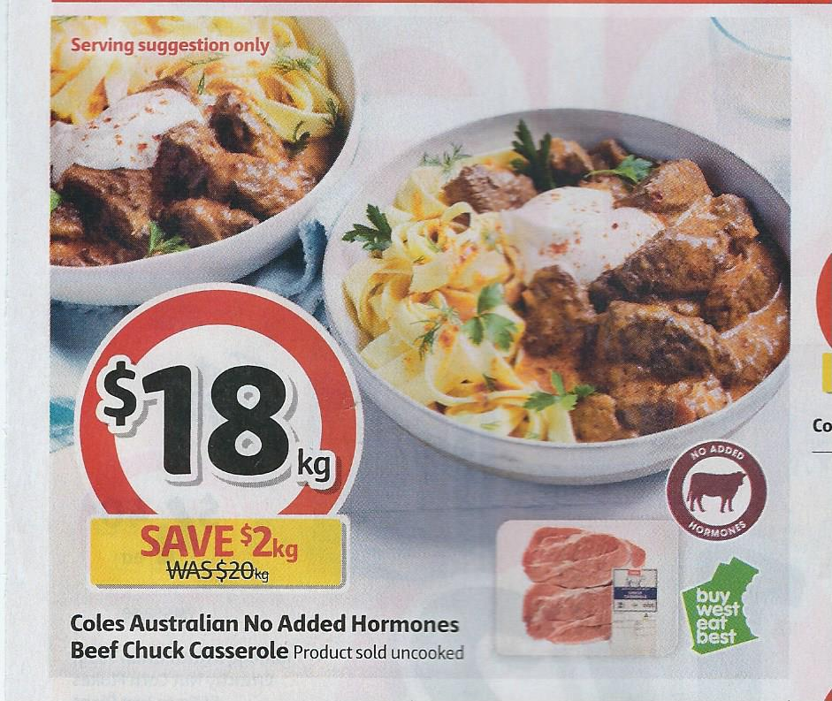
$18 per kilogram for chuck casserole beef
1 kilogram = ………. grams
500 grams = $18 ÷ 2
      = $ ......
100 grams = $18 ÷ 10
      = $ ......
200 grams = $18 ÷ 5
      = $ ......

Slide 10
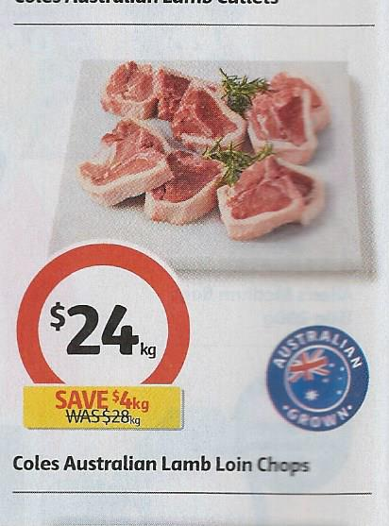
$24 per kilogram for lamb loin chops
1 kilogram = ………. grams
500 grams = $24 ÷ ……
      = $ ......
100 grams = $24 ÷ ……
      = $ ......
200 grams = $24 ÷ ……
      = $ ......

Slide 11
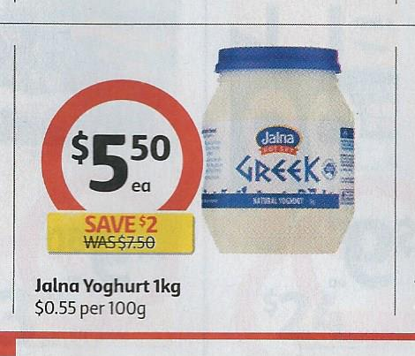
$5.50 per kilogram for Jalna yoghurt
1 kilogram = ………. grams
500 grams = $5.50 ÷ ……
      = $ ......
100 grams = $5.50 ÷ ……
      = $ ......
200 grams = $5.50 ÷ ……
      = $ ......
              Now do the Page 1 exercise

